Slide 1

Restorative Approaches in schools
Are you ready?
Ken Keighren
Depute Principal Psychologist
Fife Council Psychological Service

Slide 2
Aims of session
Describe the development of Restorative approaches within a local authority in Scotland, as part of a national initiative
Outline key factors seen to be associated with successful development
Describe the RA readiness self evaluation toolkit
Identify areas for possible future development

Slide 3
Restorative approaches aim to improve behaviour and relationships in schools by moving away from a blame and retribution model of dealing with unacceptable behaviour towards one which is based on social responsibility and self awareness.

Slide 4
How effective is what we currently do?
“Too rapid an escalation to punishment makes young people more angry than thoughtful.” Braithwaite (1989)
“By taking the culprit out of the neighbourhood or school community (by imprisonment or expulsion / suspension) we think we have removed the problem. In fact it has usually been simply relocated in time and place – and in the process, it is often exacerbated.” Judge Fred McElrea (1996)

Slide 5
  Better Behaviour Better Learning (2001)
  2003
  Peter Peacock (Scottish Minister for Education)
  Fife, Highland, North Lanarkshire
http://www.betterbehaviourscotland.gov.uk/initiatives/

Slide 6
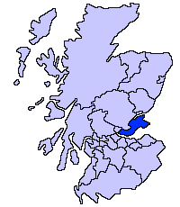
Fife – an introduction

Slide 7
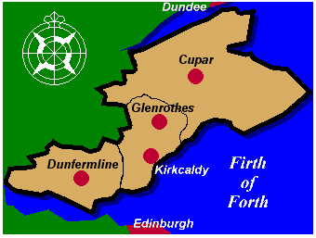
Fife – an introduction

Slide 8
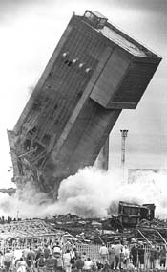
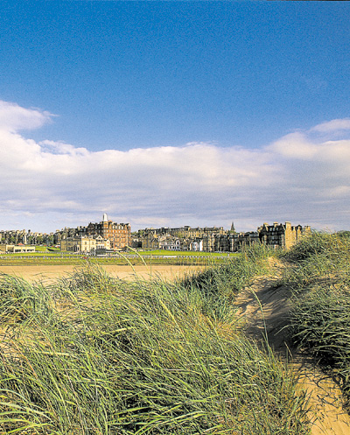
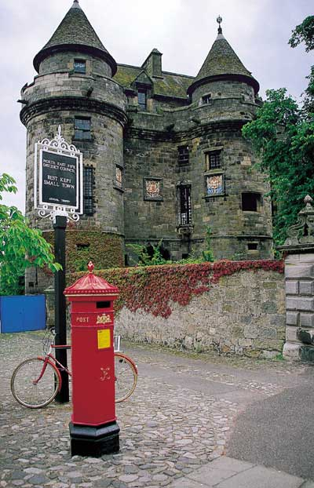

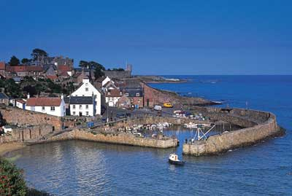
Fife – an introduction

Slide 9
Fife – some facts and figures
Population – 365000
Forecast to increase by 2.2% in next decade
Unemployment – 3.6% (Scotland – 3.0%)
Mining and defence giving way to electronics and financial services
700000 visitors per year
Increasing traffic using Forth and Tay Bridges

Slide 10
Fife - Education
3 – 18 population c.70000
15 nursery schools
146 primary schools
19 secondary schools
9 special schools

Slide 11



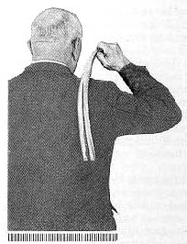

Fife – a unique contribution?
http://www.lochgelly-tawse.co.uk/

Slide 12
Fife – a unique contribution?
Corporal punishment was banned in Scottish state schools in 1986, but not in independent schools until 2000.
‘The key to the relationships model lies in the espoused aim of the school viz, to build positive relationships between teachers and pupils (or students, as this school prefers to call them). An act of indiscipline may lead to a breaking of that relationship. If that happens trust has to be restored………..Students have to work at restoring relationships rather than suffer punishment for breaking a rule.’
‘Making the change: A study of the abolition of corporal punishment, Cumming et al (SCRE) 1981

Slide 13
Links to other initiatives in Fife
Person centred approaches/planning
Positive prevention and de-escalation
Staged Intervention
Staff Welfare project
Coaching
Peer mediation
Self regulation
Cool in school (social competency)
Solution oriented schools
Citizenship/Rights Respecting Schools

Slide 14
Behaviour and Discipline strategy -3 key themes
Responsibility
Relationships
Problem solving

Slide 15
What does the research say?
  The evaluation indicates that RP, as they are developing in the pilot LAs and schools, can offer powerful and effective approaches to promoting harmonious relationships in school and to the successful resolution of conflict and harm.
  Scottish Executive 2007

Slide 16
Making Restorative Approaches work………..
values, culture, ethos
processes
skills

Slide 17
What factors contribute to success?
The Education Service has to commit
Support and involvement of SMT is critical
You need a plan for the ‘journey’
(including parental involvement)
No one size fits all
Continuing support and networking are vital
Sustainability must be built in
Schools need to be ready
See also: Fifteen essential features of successful, whole-school implementation of Restorative Practice Richard Henry (SACRO) 2009

Slide 18
How do we evaluate school ‘readiness’?
  Involves evaluating the extent to which schools value
  The need for meetings, communication, agreement
  A chance to make amends and attempt to change behaviour
  The need for reintegration with respect and assistance
  Whole school involvement
        Van Ness and Strong (2002)

Slide 19
The need for meetings, communication, agreement
Meetings are a valuable opportunity to problem solve.
Meetings about difficult topics always generate emotions; these should be acknowledged and dealt with in the meeting.
I possess effective skills in managing, contributing to and supporting others in meetings.
It’s helpful to analyse and reflect on the outcome of meetings, especially difficult ones, afterwards.

Slide 20
A chance to make amends and attempt to change behaviour
A genuine apology is an opportunity for all involved in an incident or a situation to move on.
Young people can be supported to gain better understanding of their behaviour and its consequences, and what to do to make things better.
Making reparation is a useful process in resolving difficult incidents or situations.
Young people’s behaviour can change.

Slide 21
The need for reintegration with respect and assistance
Social inclusion encourages the development of acceptable behaviour and attitudes.
Membership of social groups is important to young people, even when they find this difficult.
Young people who are struggling to participate in social groups can be supported to do this more effectively.
Punishment, criticism and social exclusion can have negative consequences, and may act against positive long term change.

Slide 22
Whole school involvement
All staff contribute meaningfully to the development and review of effective policies and practice regarding behaviour and relationships.
Staff are supported in the development of key skills in managing behaviour and relationships.
Staff feel valued and supported.
Staff model positive social relationships and behaviour.

Slide 23
Readiness assessment – a rough guide
Practice consistent with RA
low
high
Identify barriers; check culture, ethos, attitudes – don’t launch RA!!
Commend and support – share practice
high
Awareness of RA
low
Raise awareness of RA – proceed with caution
Raise awareness of RA
– encourage development

Slide 24
Large primary school (c. 400) in area of high social deprivation.
Former mining and shipbuilding community
20 teachers, 10 pupil support assistants
Enduring concerns about pupil behaviour both in the school and in the wider community.
Using the toolkit with one primary school

Slide 25
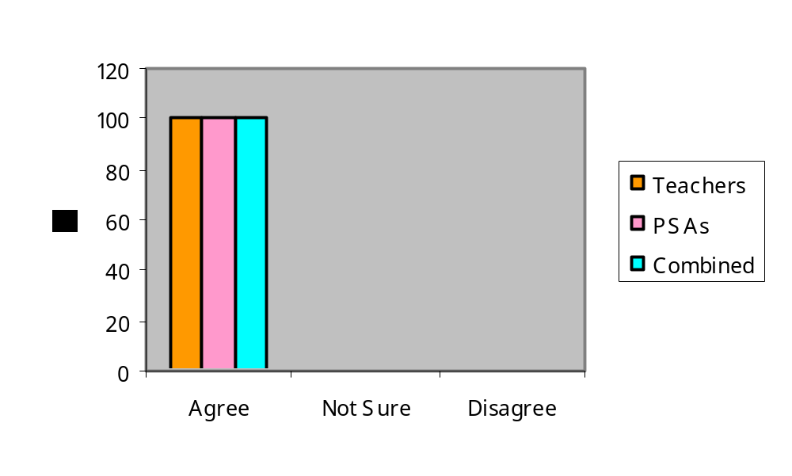
2.2 Young people can be supported to gain better understanding of their behaviour and its consequences, and what to do to make things better.

Slide 26
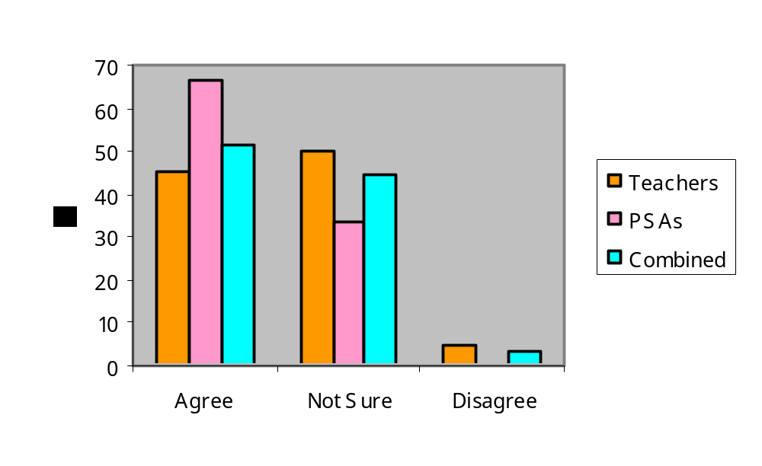
3.1 Social inclusion encourages the development of acceptable behaviour and attitudes.

Slide 27
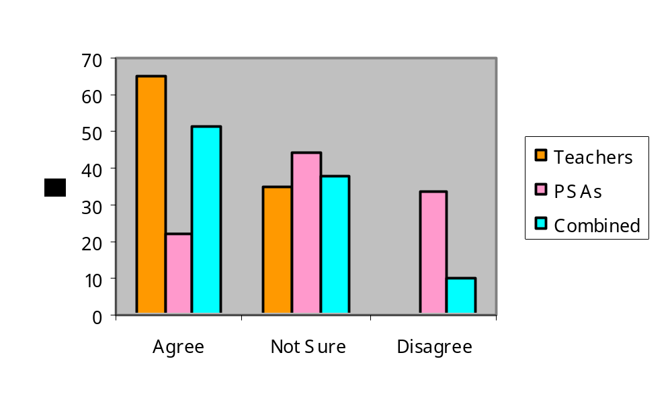
3.4 Punishment, criticism and social exclusion can have negative consequences, and may act against positive long term change.

Slide 28
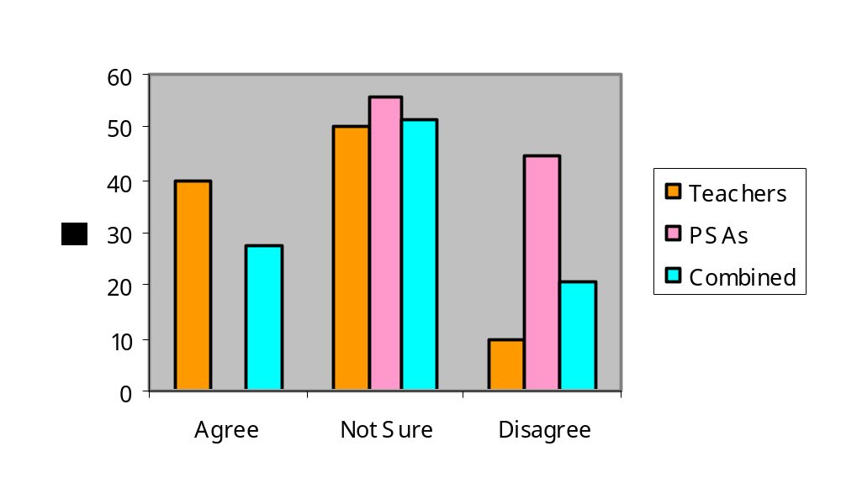
4.3 Staff feel valued and supported.

Slide 29
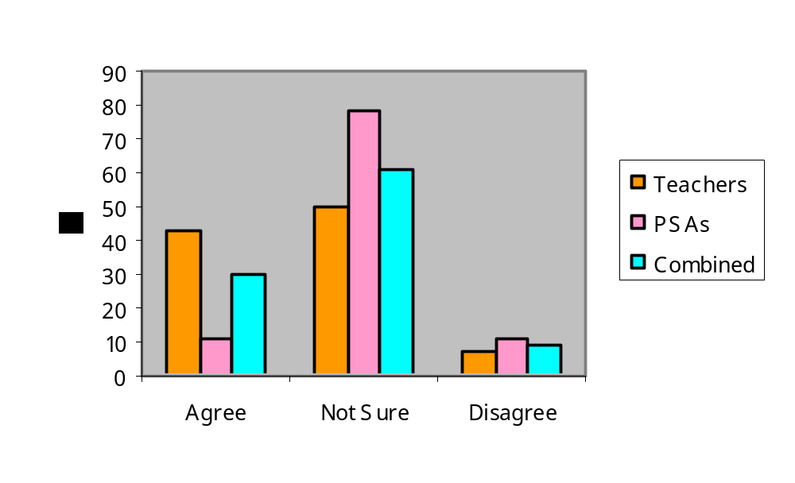
4.4 Staff model positive social relationships and behaviour.

Slide 30
Some questions……………..
How relevant and useful is the concept of readiness?
Are there any other aspects which might be evaluated?
How can the results best be used?

